Slide 1
Demand, Supply, and Market Equilibrium
From:
Book 1: Chapter 3

Slide 2
Demand
Demand is a schedule or a curve that shows the various amounts of a product that consumers are willing and able to purchase at each of a series of possible prices during a specified period of time.
Demand shows the quantities of a product that will be purchased at various possible prices, other things equal.

Slide 3
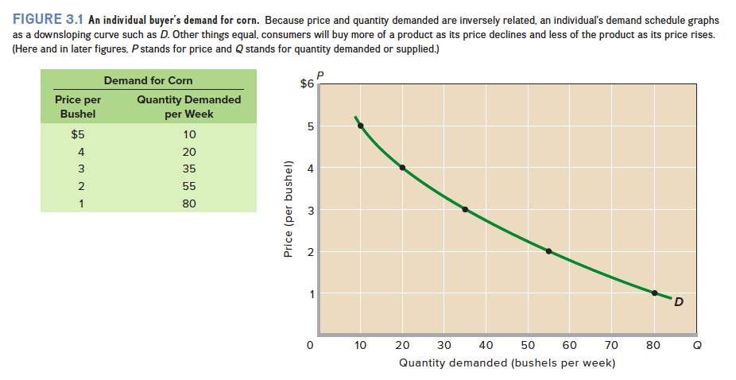
The Demand Curve

Slide 4
Law of Demand
Other things equal, as price falls, the quantity demanded rises, and as price rises, the quantity demanded falls.
A negative or inverse relationship between price and quantity demanded.
Reasons:
Common sense: Price is an obstacle that deters consumers from buying.
Law of diminishing marginal utility
Income effect and substitution effect

Slide 5
Determinants of Demand
Other factors that can and do affect purchases. i.e. “other things equal”.
When any of these determinants changes, the demand curve will shift to the right or left, - Demand Shifters
Consumers’ tastes (preferences),
The number of buyers in the market,
Consumers’ incomes,
The prices of related goods, and
Consumer expectations.

Slide 6
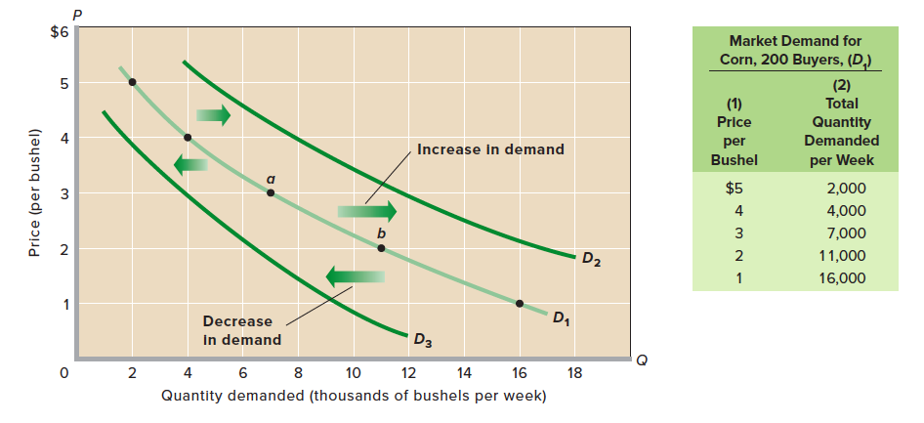
Changes in Demand
Change in Demand
Change in Quantity Demanded

Slide 7
Changes in Demand
Tastes: A favorable change in consumer tastes (preferences) for a product –
Demand will increase; the demand curve will shift rightward. And vice versa
Number of Buyers: An increase in the number of buyers in a market is likely to increase demand and vice versa
Income: How changes in income affect demand is a more complex matter.
Superior or normal goods VS inferior goods

Slide 8
Changes in Demand (Cont’d)
Prices of Related Goods: A change in the price of a related good may either increase or decrease the demand for a product, depending on whether the related good is a substitute or a complement
Consumer Expectations: Changes in consumer expectations may shift demand. Expectation of higher future prices may result in increasing current demand.

Slide 9
Table 3.1. Determinants of Demand: Factors That Shift the Demand Curve
Determinant | Examples
Change in buyers’ tastes | Physical fitness rises in popularity, increasing the demand for jogging shoes and bicycles; cell phone popularity rises, reducing the demand for land-line phones.
Change in the number of buyers | A decline in the birthrate reduces the demand for children’s toys.
Change in income | A rise in incomes increases the demand for normal goods such as restaurant meals, sports tickets, and necklaces while reducing the demand for inferior goods such as cabbage, turnips, and inexpensive wine.
Change in the prices of related goods | A reduction in airfares reduces the demand for bus transportation (substitute goods); a decline in the price of DVD players increases the demand for DVD movies (complementary goods).
Change in consumer expectations | Inclement weather in South America creates an expectation of higher future coffee bean prices, thereby increasing today’s demand for coffee beans.

Slide 10
Supply
Supply is a schedule or curve showing the various amounts of a product that producers are willing and able to make available for sale at each of a series of possible prices during a specific period.
Supply shows the quantities a product that will be supplied at various prices, other things equal.

Slide 11
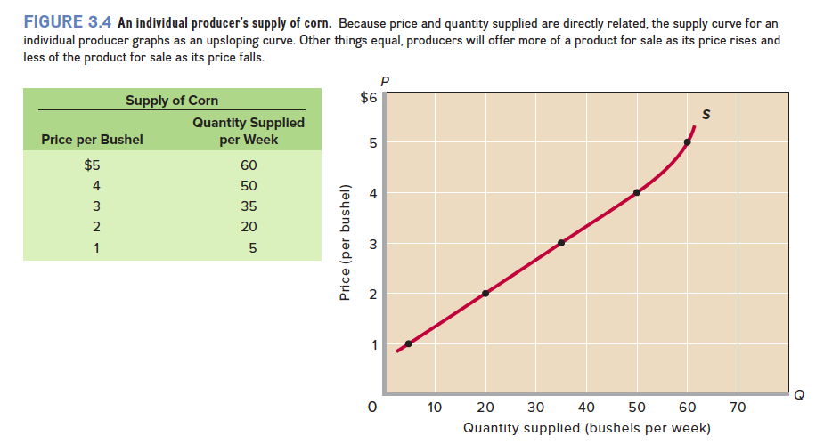
The Supply Curve

Slide 12
Law of Supply
As price rises, the quantity supplied rises; as price falls, the quantity supplied falls. This relationship is called the law of supply.
Reason:
Price is an obstacle for consumer but revenue for supplier
It serves as an incentive to produce and sell a product

Slide 13
Determinants of Supply
The basic determinants of supply, the supply shifters, are:
resource prices,
technology,
taxes and subsidies,
prices of other goods,
producer expectations, and
the number of sellers in the market.
The key idea is that costs are a major factor underlying supply curves;
anything that affects costs (other than changes in output itself) usually shifts the supply curve.

Slide 14
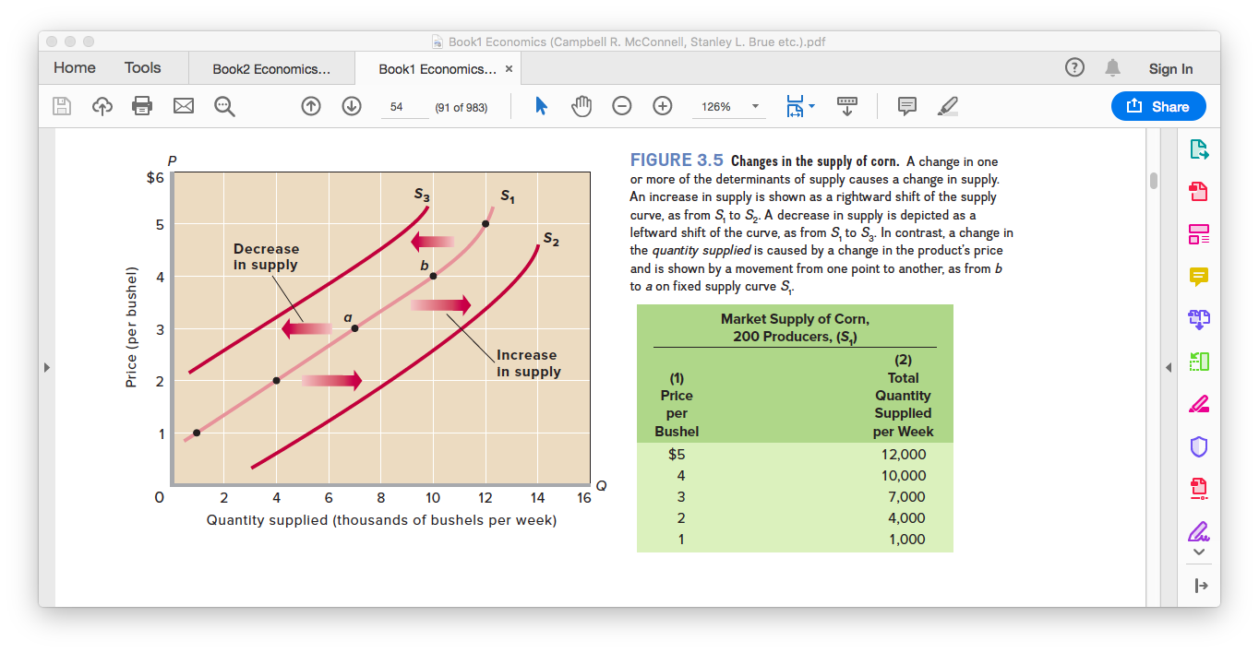
Changes in Supply
Change in Quantity Supplied
Change in Supply

Slide 15
Changes in Supply
Resource Prices: Higher resource prices raise production costs and, assuming a particular product price, squeeze profits.
Technology: Improvements in technology (techniques of production) enable firms to produce units of output with fewer resources.
Taxes and Subsidies: Businesses treat most taxes as costs. An increase in sales or property taxes will increase production costs and reduce supply.
In contrast, subsidies are “taxes in reverse.” If the government subsidizes the production of a good, it in effect lowers the producers’ costs and increases supply.

Slide 16
Changes in Supply (Cont’d)
Prices of Other Goods: Firms that produce a particular product can sometimes use their plant and equipment to produce alternative goods.
Producer Expectations: Changes in expectations about the future price of a product may affect the producer’s current willingness to supply that product.
It is difficult, however, to generalize about how a new expectation of higher prices affects the present supply of a product.
Number of Sellers: Other things equal, the larger the number of suppliers, the greater the market supply.

Slide 17
Determinants of Supply: Factors That Shift the Supply Curve
Determinant | Examples
Change in resource prices | A decrease in the price of microchips increases the supply of computers; an increase in the price of crude oil reduces the supply of gasoline.
Change in technology | The development of more effective wireless technology increases the supply of cell phones.
Change in taxes and subsidies | An increase in the excise tax on cigarettes reduces the supply of cigarettes; a decline in subsidies to state universities reduces the supply of higher education.
Change in prices of other goods | An increase in the price of cucumbers decreases the supply of watermelons.
Change in producer expectations | An expectation of a substantial rise in future log prices decreases the supply of logs today.
Change in the number of suppliers | An increase in the number of tattoo parlors increases the supply of tattoos; the formation of women’s professional basketball leagues increases the supply of women’s professional basketball games.

Slide 18
Market Equilibrium
With neither a shortage nor a surplus, the market is in equilibrium, i.e. “in balance” or “at rest.”
Equilibrium Price: The price where the intentions of buyers and sellers match.
Equilibrium Quantity: The quantity at which the intentions of buyers and sellers match.
Graphically, the equilibrium price and quantity are indicated by the intersection of the supply curve and the demand curve

Slide 19
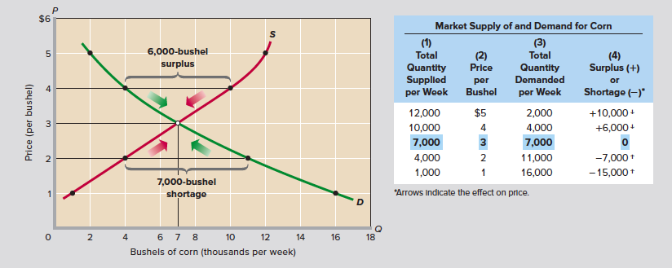
Market Equilibrium (Cont’d)

Slide 20
Market Equilibrium (Cont’d)
Surplus and Shortage
At any above-equilibrium price, quantity supplied exceeds quantity demanded.
The result is a surplus (or excess supply )
Any price below the equilibrium price, quantity demanded would exceed quantity supplied.
The result is a shortage (or excess demand)

Slide 21
Uber and Dynamic Pricing
A short reading on Page 58

Slide 22
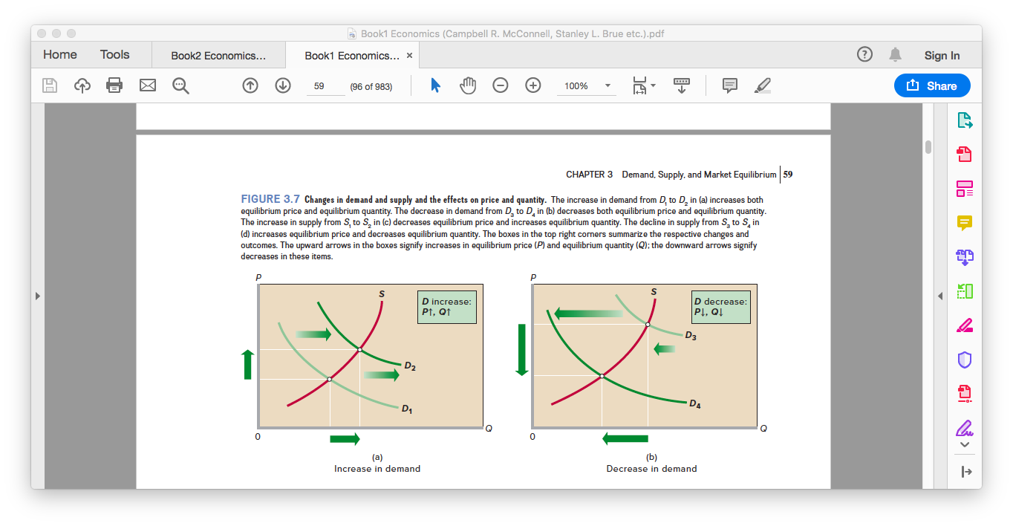
Changes in Demand and Equilibrium

Slide 23
Changes in Demand and Equilibrium

Slide 24
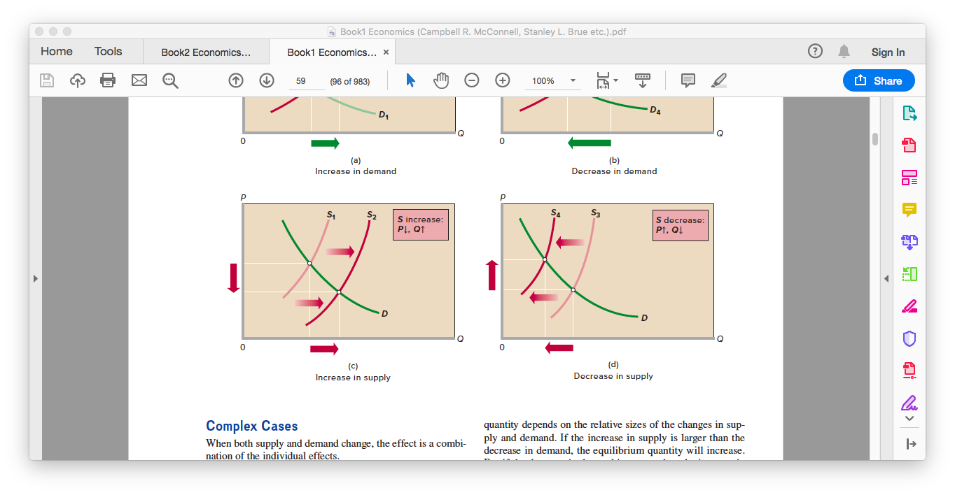
Changes in Supply and Equilibrium

Slide 25
Changes in Supply and Equilibrium

Slide 26
Complex Cases
What effects will be there on equilibrium price and equilibrium quantity? In case of:
Supply Increase; Demand Decrease
Supply Decrease; Demand Increase
Supply Increase; Demand Increase
Supply Decrease; Demand Decrease

Slide 27
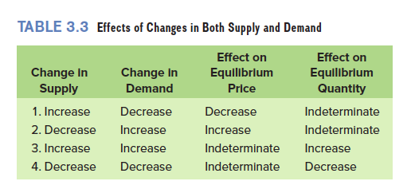
Complex Cases (Cont’d)

Slide 28
Application: Government-Set Prices
Price Ceiling
The maximum legal price a seller may charge for a product or service.
Set below equilibrium price
Examples: price ceiling on gasoline, rent controls
Results in shortage
Rationing Problem
Black Markets

Slide 29
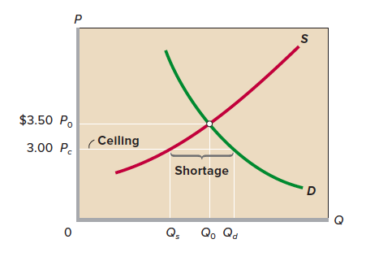
Price Ceiling

Slide 30
Application: Government-Set Prices
Price Floor
A minimum price fixed by the government.
Above equilibrium price
Examples: Supported prices for agricultural products and current minimum wages
Results in surplus
Consequences?

Slide 31
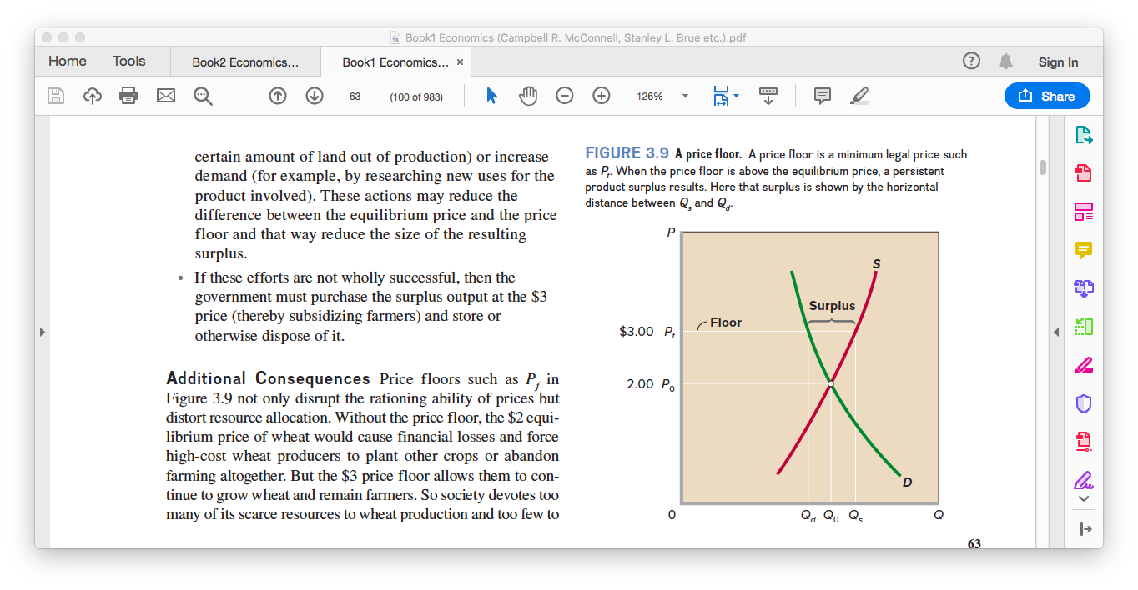
Price Floor

Slide 32
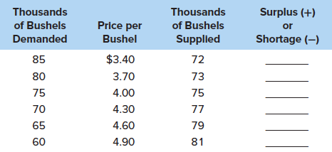
Problem
What is the equilibrium price?
Graph the demand for wheat and the supply of wheat. Label equilibrium price P and equilibrium quantity Q.
Suppose that the government establishes a price ceiling of $3.70 for wheat. What might prompt the government to establish this price ceiling? Explain carefully the main effects. Demonstrate your answer graphically.

